Slide 1

CANNABIS FOOD CONCENTRATES
AND CANNANUTRIENTS
NL PRACTITIONER REFERENCE GUIDE
Formulations by
BJ Futter – Church of Ubuntu &
Nikki Freeburn – Natural Lore

Slide 2

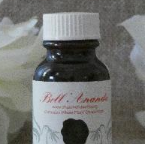
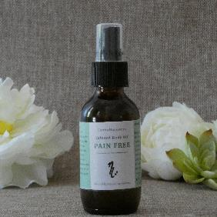
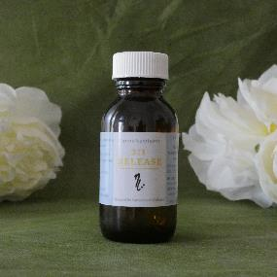
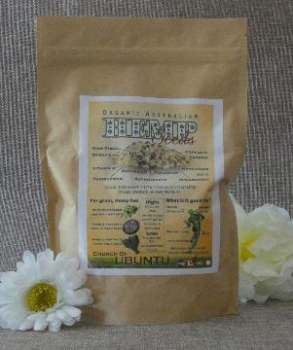
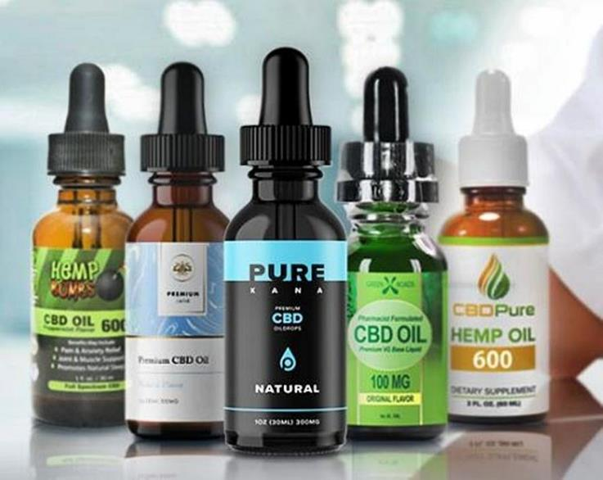
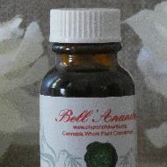
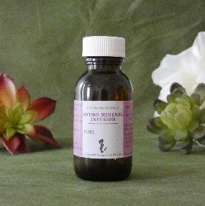
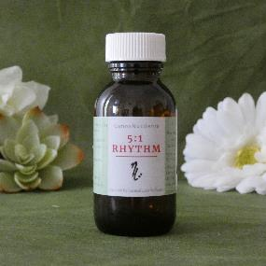
Audio
Whole Plant Formulas. NOT Medical Cannabis Products
Please refer to updated Product list for current available formulas as this document is for training and reference purposes only.

Slide 3

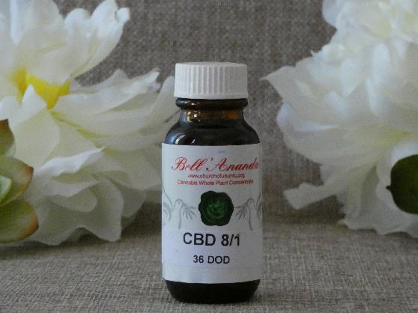
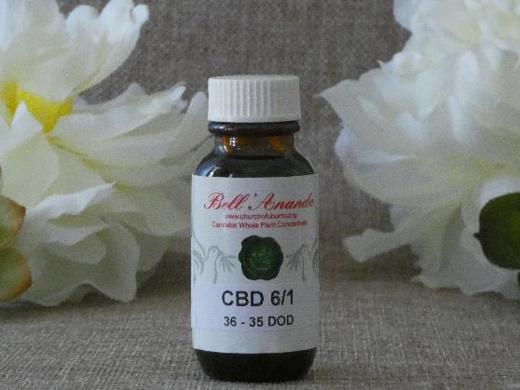
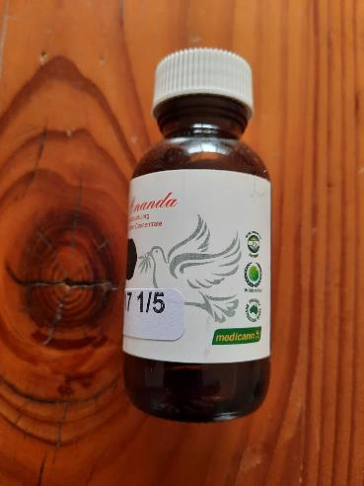
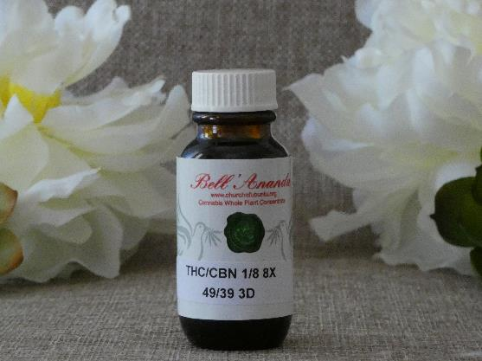
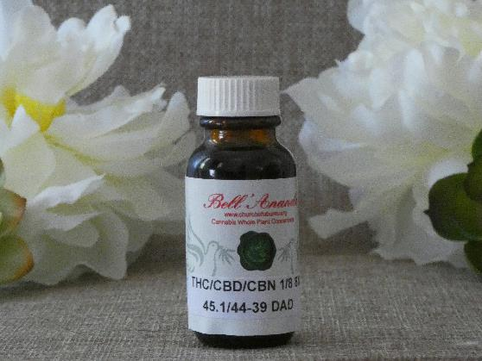
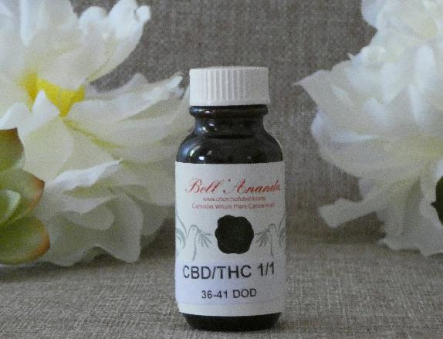
Cannabis Food Concentrates
Audio
Bell Ananda/Church of Ubuntu Oil Range
made by BJ Futter

Slide 4
Audio
Levels of Cannabinoid Content / Ratios
Relates to both Bell Ananda Oil Range and Natural Lore Wellness Range
Includes 5/1, 2/1, & 1/6

Slide 5
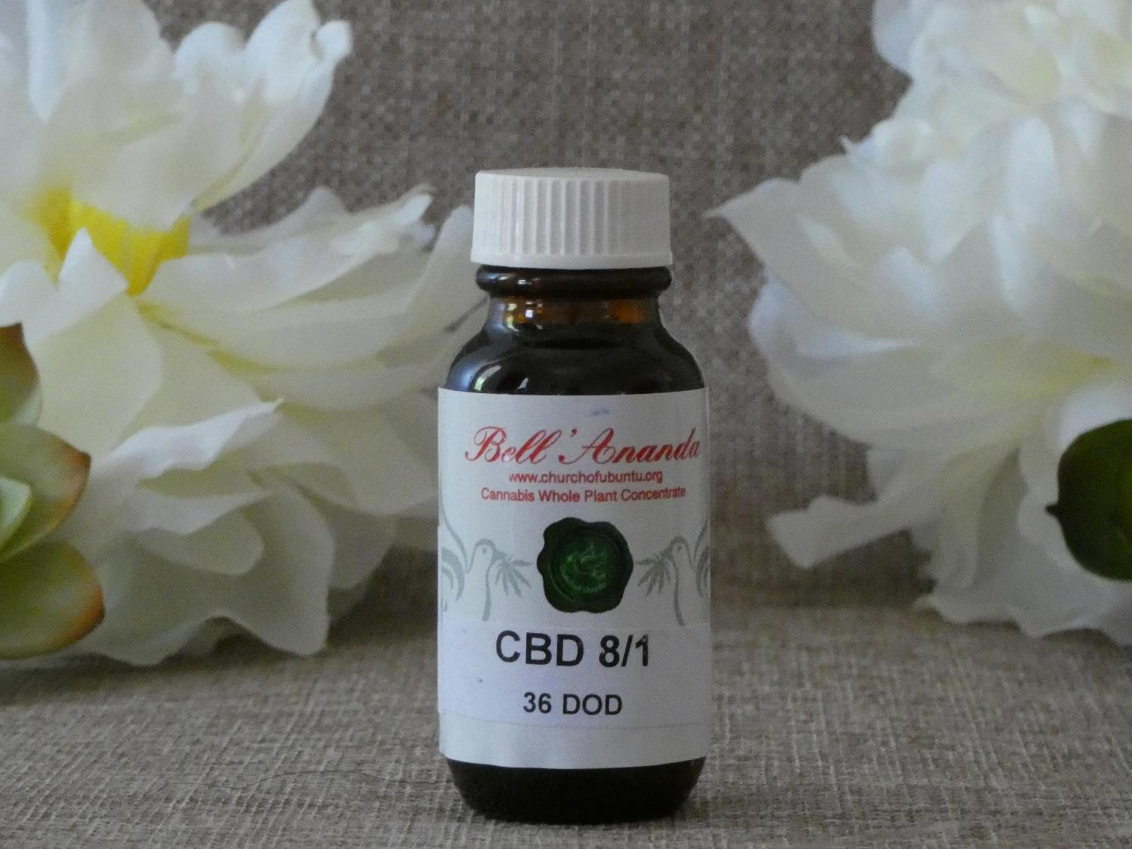
8/1
CBD Dominant
Medium level concentrate
Audio

Slide 6

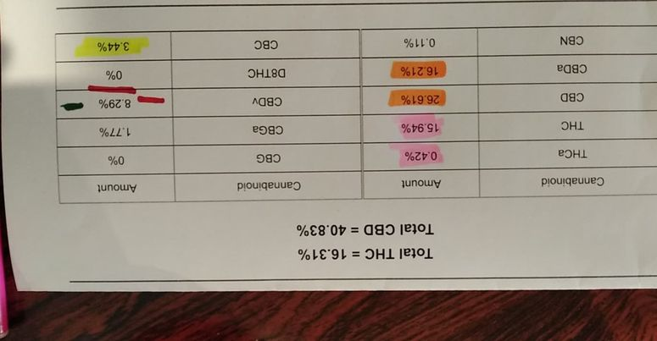
6/1
CBD Dominant
Combination of two strains
Jahs 11 (also used in 8/1) & DDF (or other available Sativa THCA strains)
Medium Level Concentrate
Audio

Slide 7

Audio
1/1
Balanced Cannabinoid structure i.e. CBD/THC
Medium Level Concentrate

Slide 8
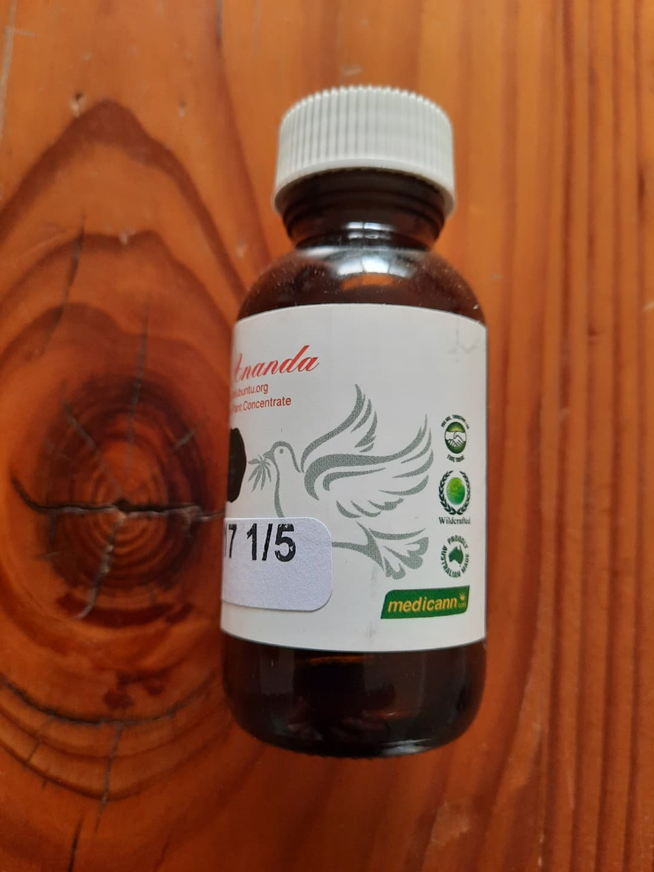
Audio
1/5
THC Dominant
High Level concentrate

Slide 9
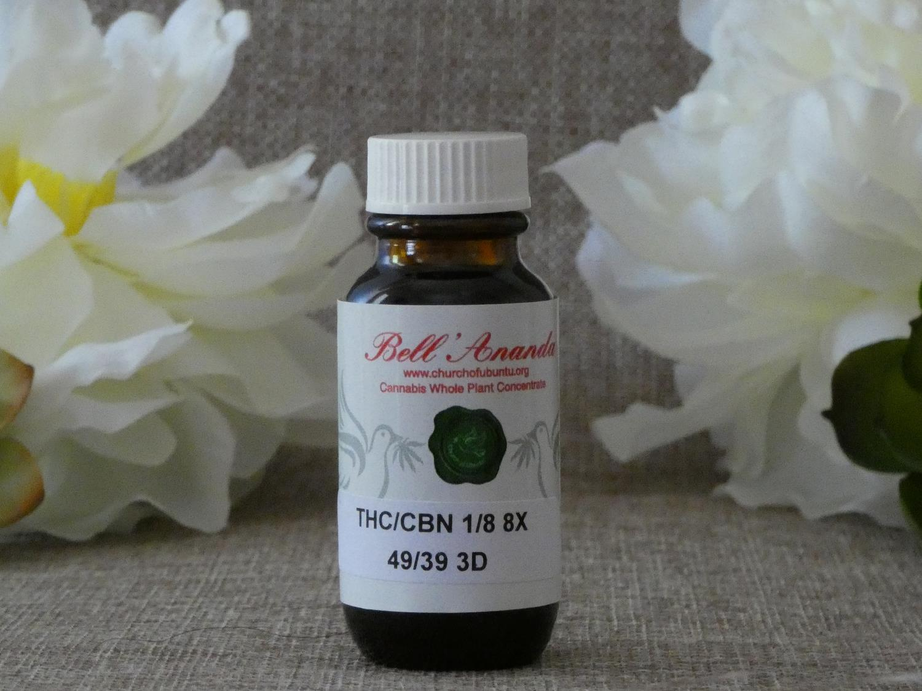
Audio
1/8 Mid Concentrate
Medium Level Concentrate

Slide 10

1/8 HIGH CONCENTRATE
High level Concentrate
Audio

Slide 11
Gaia
Balanced Cannabinoid structure i.e. CBD/THC
Low Level Concentrate
Good oil for pets
Audio

Slide 12



SLEEP
Audio
An approach to addressing sleeping issues

Slide 13
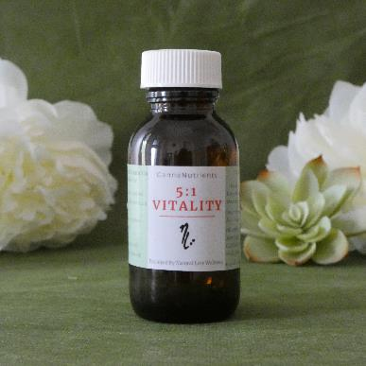
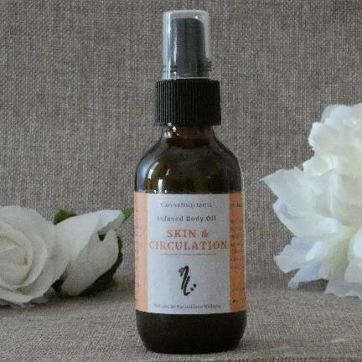
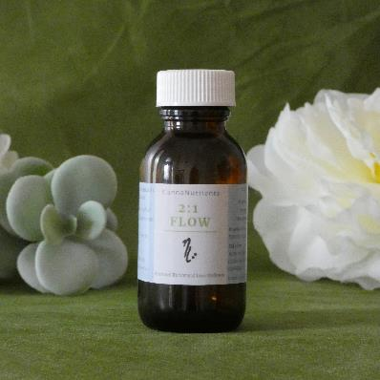
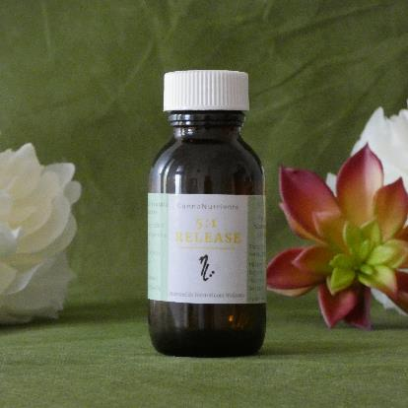
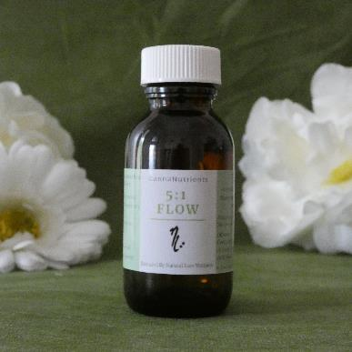

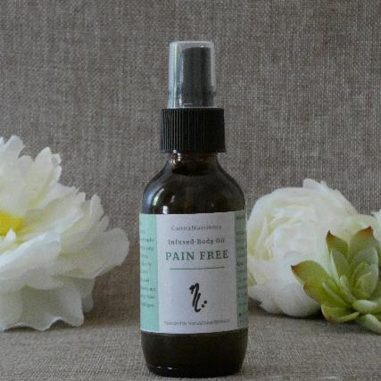

Audio
CannaNutrients
Natural Lore Wellness Range
made by Nikki Freeburn

Slide 14
12 Natural Lores of Wellness
Audio

Slide 15

Tea Blends
Laying the foundation of all Natural Lore Wellness products.
Play first
Play Second

Slide 16
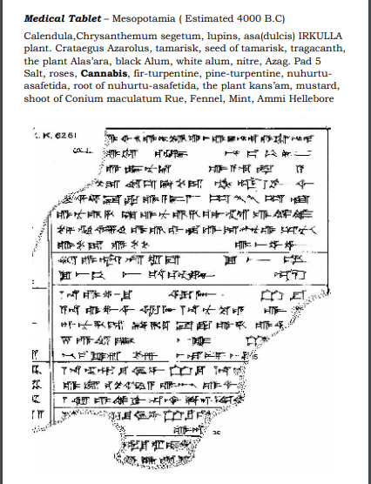

Hydro Mineralized Infusion (HMI)
Hydro Mineralized Infusion is a unique cannabinoid formula. This range of formulas are salt water based and infused with chosen botanicals to assist with cell detoxification, nutrient uptake and activate the body’s natural Immune response for healing. Needs to be refrigerated
Audio

Slide 17
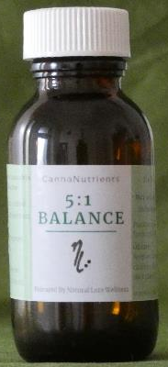

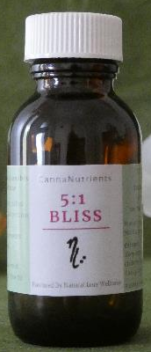
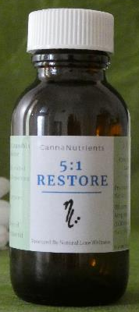
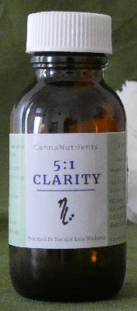

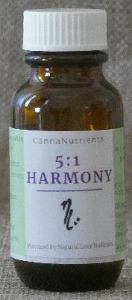
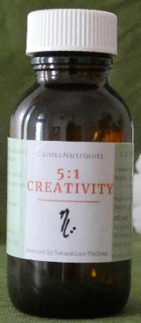
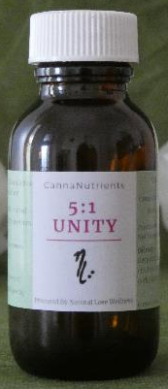


5:1 Range
Play first
CBD dominant formulas infused with the Tea Blends
Low/Medium level Concentrate, explained in recording.
Play second

Slide 18

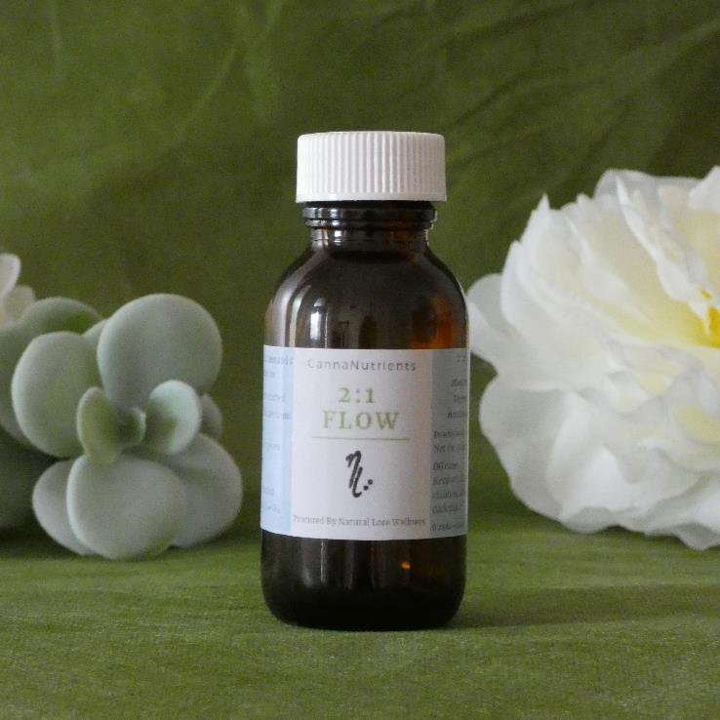
Audio
2:1 Range
Balanced Cannabinoid structure i.e. CBD/THC
Low/Medium Level Concentrate

Slide 19
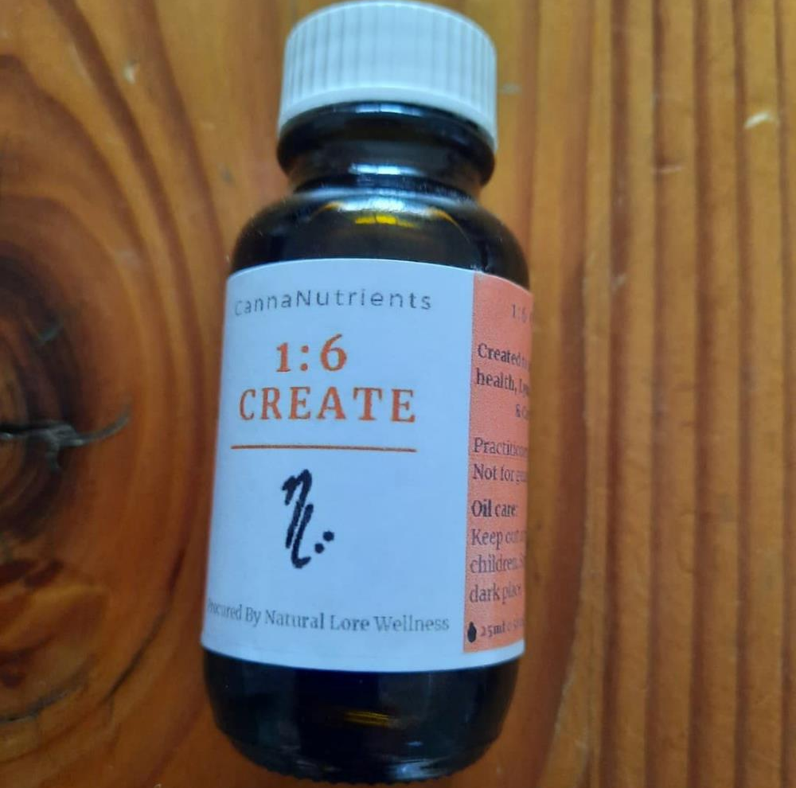
1:6
Audio
THC Dominant
Low/Medium Level concentrate

Slide 20
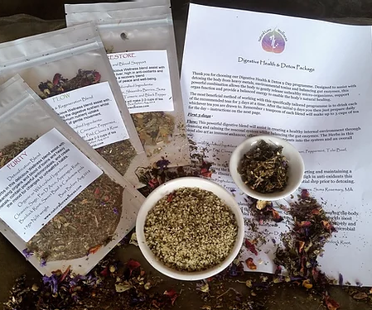

9 Day Endocannabinoid Activation
Audio

Slide 21
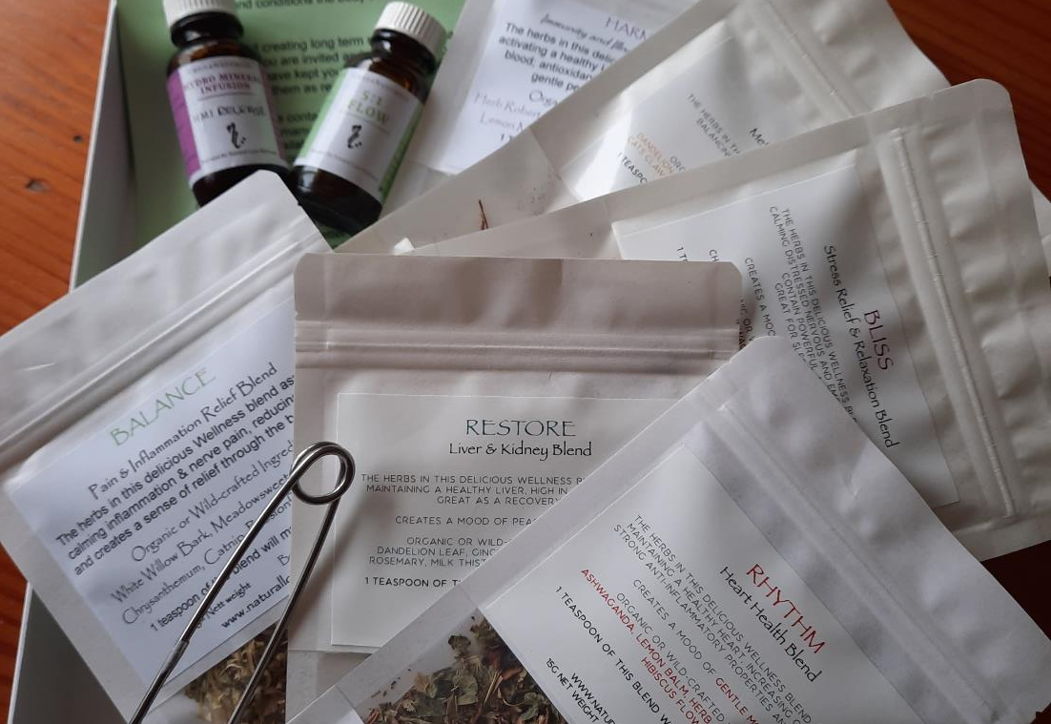
24 Day Protocol
Play first
Play second

Slide 22
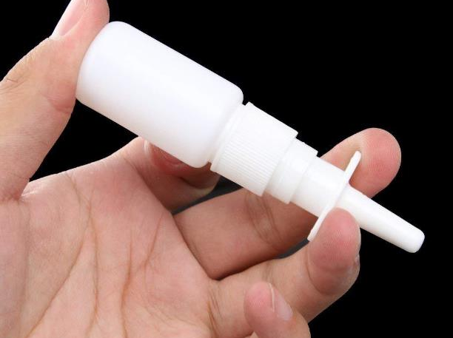
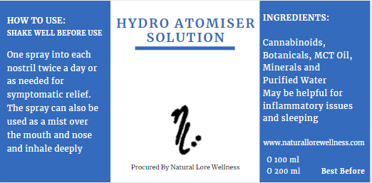
Hydro Atomiser Solution
Hydro Atomizer Solution is a unique cannabinoid formula designed as a nasal spray or face mist. This range of formulas are an emulsion of water and oil and infused with chosen botanicals to assist with cell detoxification, nutrient uptake and activate the body’s natural Immune response for healing. Needs to be refrigerated

Slide 23

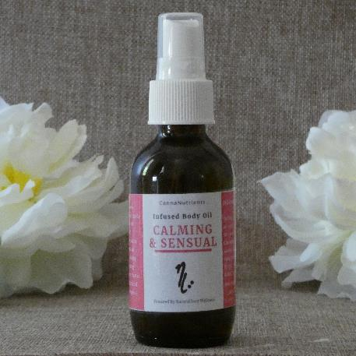
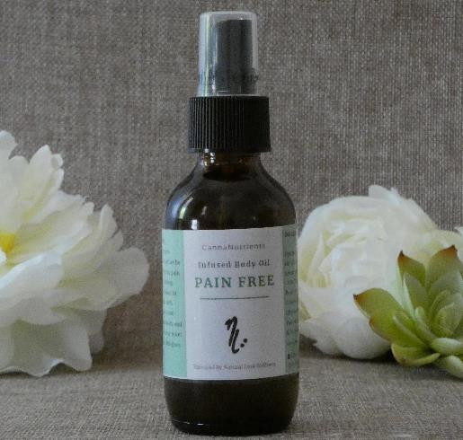
Topical Oils
Audio
This specially formulated 100% natural body oil can be used topically.
Optimum Grade MCT oil infused with CBD stems and appropriate tea blend

Slide 24
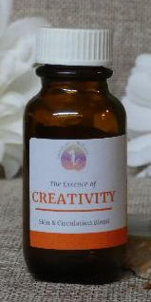
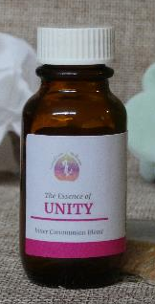
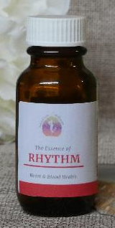
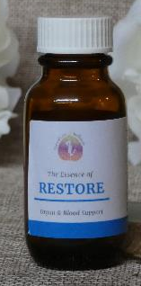
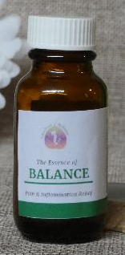
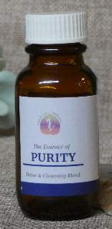
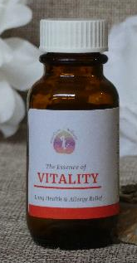
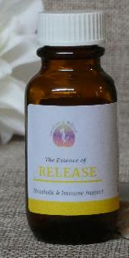
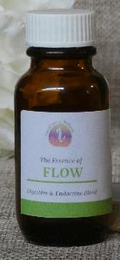
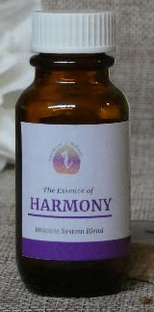


Audio
Essence Range
Natural Lore Wellness has introduced a range of Essence formulas that gently infuse our uniquely blended herbal Tea Range in the highest quality MCT oil and recommended to be taken as daily nourishment via drops on the tongue. For anyone using Whole Plant Cannabis Formulas for their health and well-being, these Essences are also bioenergetically created to complement these oils by enhancing the terpene range and therapeutic elements according the blends’ properties.

